Slide 1


Kubernetes Cluster Deployment and Static Website Monitoring
This presentation overviews the deployment and monitoring of a Kubernetes cluster. We'll monitor a static website using Prometheus, Grafana, and Splunk. The project provides real-time observability and log analysis in a distributed environment.
by Sachin Vishwakarma

Slide 2
Project Overview
Purpose
Challenges
Monitoring Kubernetes clusters is critical. It ensures application availability and performance. Static website monitoring enhances user experience. It also identifies potential issues early.
Managing distributed applications can be complex. Centralized observability is often lacking. Effective log analysis is essential for troubleshooting and maintaining system health.

Slide 3





Project Objectives
Deploy Kubernetes Cluster
Provision a Kubernetes cluster on AWS EC2 instances using kubeadm.
Deploy Static Website
Set up a static website using NGINX as the web server.
Monitor System Metrics
Implement Prometheus and Grafana to monitor cluster metrics.
Monitor Logs with Splunk
Integrate Splunk for centralized log management and analysis.

Slide 4





Tools & Technologies Used
AWS EC2
Kubernetes
NGINX
Prometheus
We will leverage AWS EC2 with Ubuntu for our infrastructure. Kubernetes, using kubeadm, orchestrates the cluster. NGINX serves the static website. Prometheus and Grafana provide monitoring, while Splunk manages logs.

Slide 5
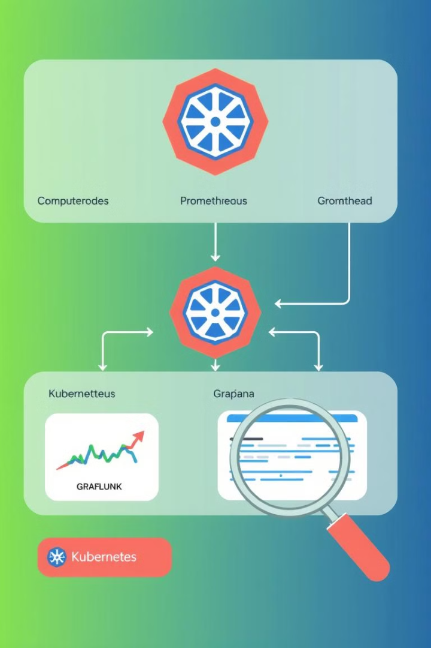
Architecture Diagram
The architecture includes master and worker nodes. Prometheus collects metrics via node exporters. Grafana visualizes the data. Splunk Enterprise manages logs forwarded by Universal Forwarders.

Slide 6




Kubernetes Cluster Setup
Master Configuration
Initialize the Kubernetes master node using kubeadm.
Worker Configuration
Join worker nodes to the master node.
NGINX Deployment
Deploy a static website on NGINX.

Slide 7



Prometheus & Grafana Setup
Grafana dashboard
1
Import and configure Grafana dashboard
Node exporter
2
Configure node exporter
Prometheus Operator
3
Install Prometheus Operator
Installing the Prometheus Operator facilitates managing Prometheus instances in Kubernetes. Configuring node exporters on each node allows Prometheus to scrape metrics. Dashboards visualize metrics for easy analysis.

Slide 8



Splunk Integration
Universal Forwarder
Install Universal Forwarder on Master
Splunk Enterprise
Install Splunk Enterprise on Worker
Log Forwarding
Configure forwarding paths
Splunk Enterprise is installed on a worker node for centralized log management. A Universal Forwarder on the master node forwards logs. Configuring the correct paths ensures comprehensive log collection.

Slide 9
Conclusion & Future Scope
Achievements
Future Scope
Successfully monitored metrics and logs.
Automate deployments with Helm or Ansible.
Achieved real-time observability.
Integrate alerting.
Improved understanding of DevOps stack.
Explore AIOps integration.

